Slide 1

Heart Health Data Analysis

Slide 2

Objectives
Which age group has the highest chances of getting heart disease
Relationship between Chest Pain Severity and Heart Disease
Do male are more prone to heart disease or female?

Slide 3
The Process
Data Collection
Data Cleaning
Data Analysis
Insights

Slide 4

Data Collection
The Data has been collected in the form of a csv file named “Heart Disease Data.csv”.
File contains Heart Health data of about 1025 people.

Slide 5
Data Cleaning
Changed the column names to – Age, Gender, CP, RPB(Diastolic), SC, FBS, RER, MHRA, EIA, Oldpeak, Slope, Flourosopy, Thallium Test, HD
CP – Chest Pain Severity
RPB(Diastolic) – Resting Blood Pressure
SC – Serum Cholesterol in mg/dl
FBS – Is Fasting Blood Glucose greater than 120mg
RER – Resting Electrocardiographic Results
MHRA – Maximum Heart Rate Achieved
EIA – Exercise Induced Angina

Slide 6
Data Cleaning
Oldpeak - ST depression induced by exercise relative to rest
Slope - the slope of the peak exercise ST segment
Flourosopy – Number of major vessels coloured by flourosopy
Thallium Test – To check how well blood flows to the heart muscles. 0-Normal, 1-fixed defect, 2-reversable defect
Changed value 0 and 1 of Gender column to Male and Female respectively.
Some columns has outliers. Replaced those values with the median of that column using Python.

Slide 7
Data Cleaning
Some values of Oldpeak column has value zero, which is not possible in practical situation. It is always greater than zero. So, replaced those zero values with the median of Oldpeak Column.
According to dataset metadata, Thallium Test column should only have values 0,1 and 2. But some rows has value 3, which is incorrect. So, I replaced all the values of 3 with 2.

Slide 8
Selecting visual aids
Enhancing your presentation

Slide 9
Effective delivery techniques
This is a powerful tool in public speaking. It involves varying pitch, tone, and volume to convey emotion, emphasize points, and maintain interest.
Pitch variation
Tone inflection
Volume control
Effective body language enhances your message, making it more impactful and memorable.
Meaningful eye contact
Purposeful gestures
Maintain good posture
Control your expressions

Slide 10
Navigating Q&A sessions
Know your material in advance
Anticipate common questions
Rehearse your responses
Maintaining composure during the Q&A session is essential for projecting confidence and authority. Consider the following tips for staying composed:
Stay calm
Actively listen
Pause and reflect
Maintain eye contact

Slide 11
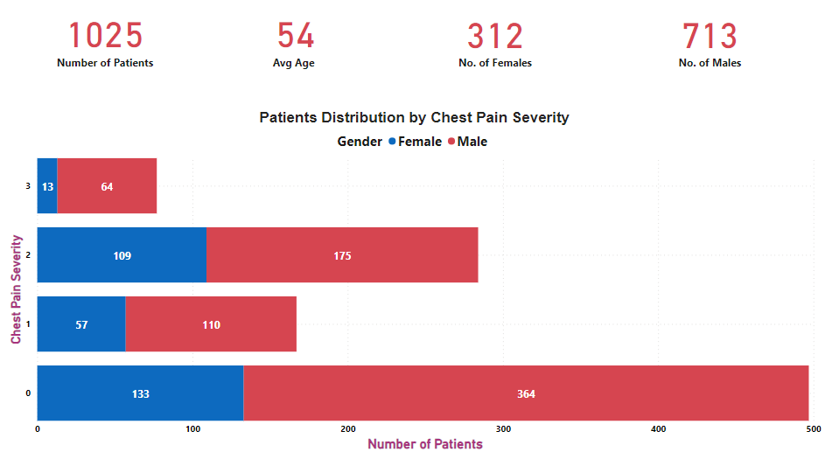
Data Analysis

Slide 12
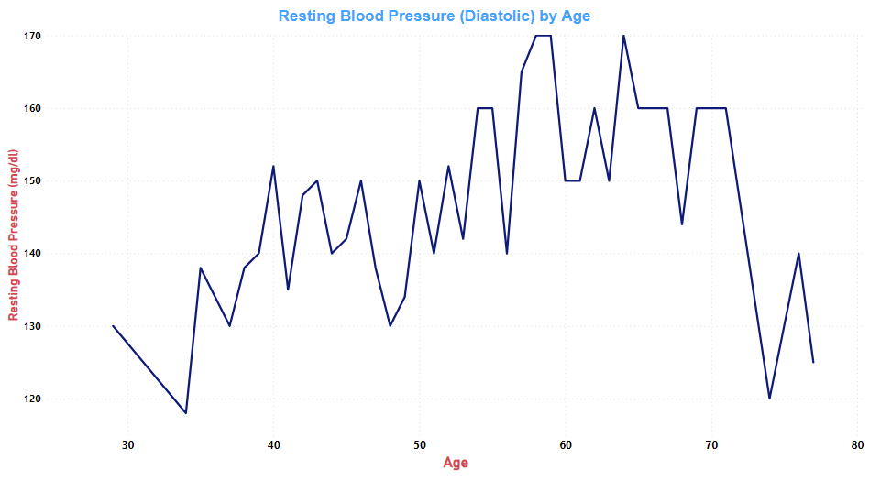
Data Analysis

Slide 13
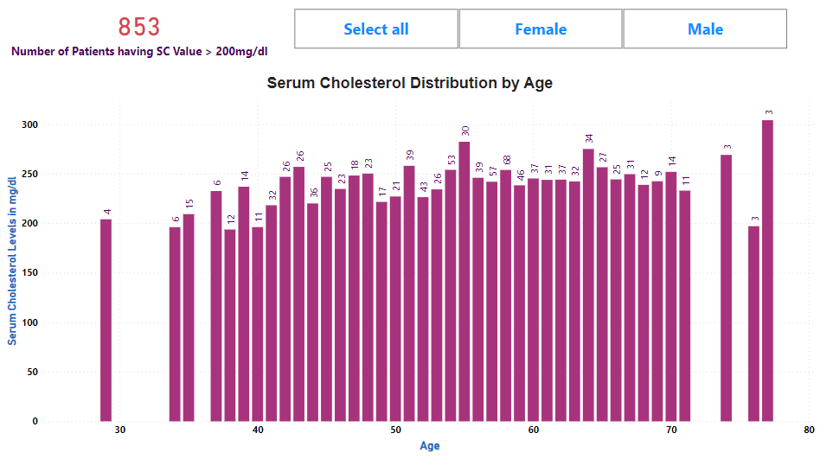
Data Analysis

Slide 14
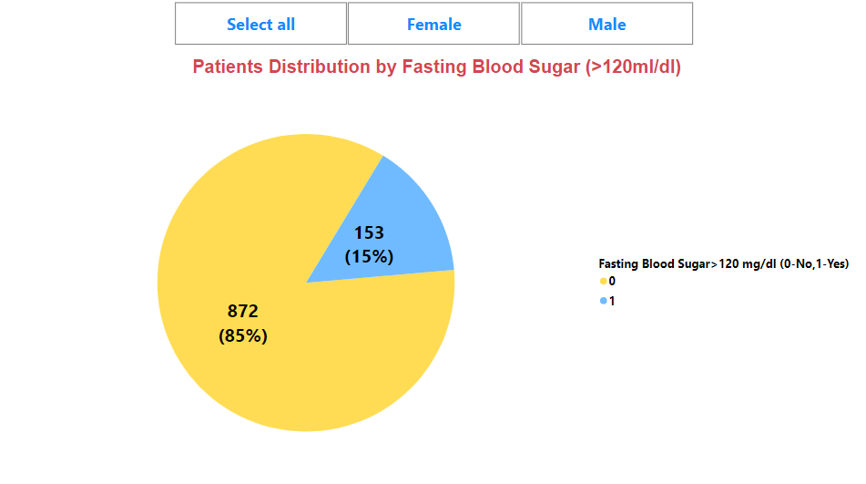
Data Analysis

Slide 15
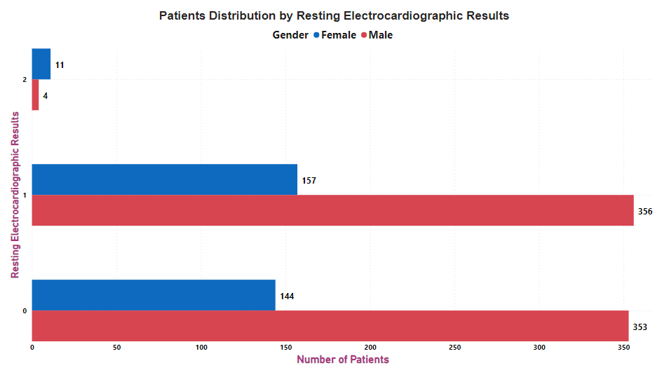
Data Analysis

Slide 16
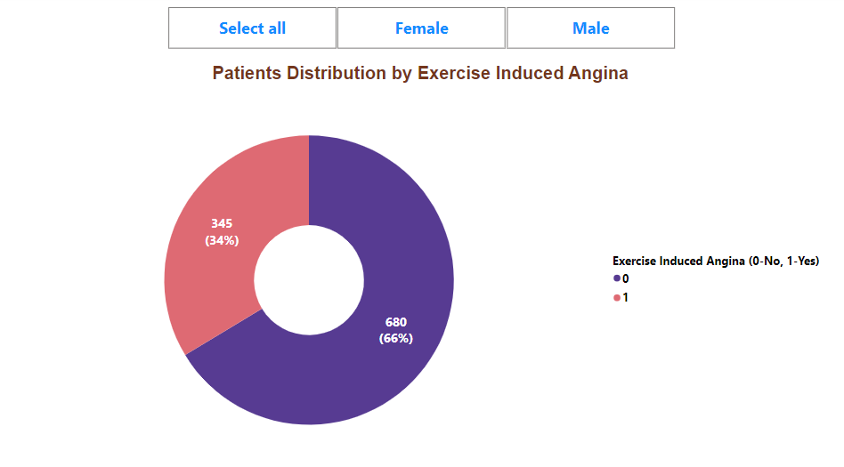
Data Analysis

Slide 17
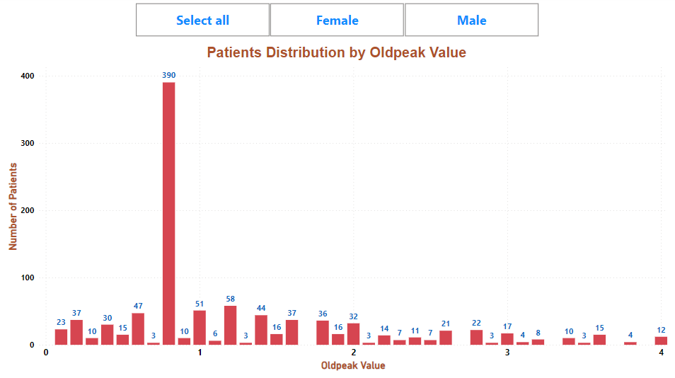
Data Analysis

Slide 18
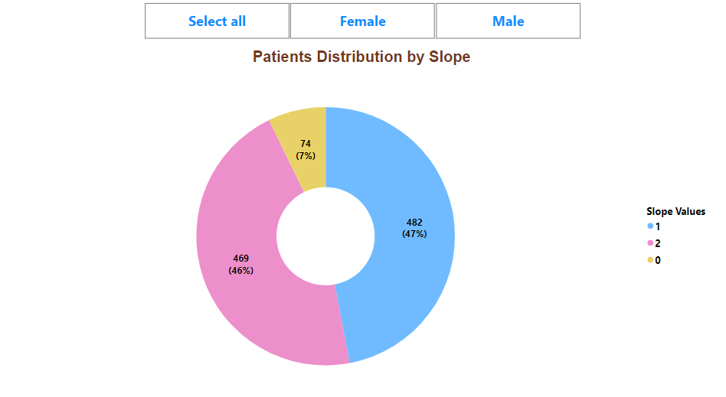
Data Analysis

Slide 19
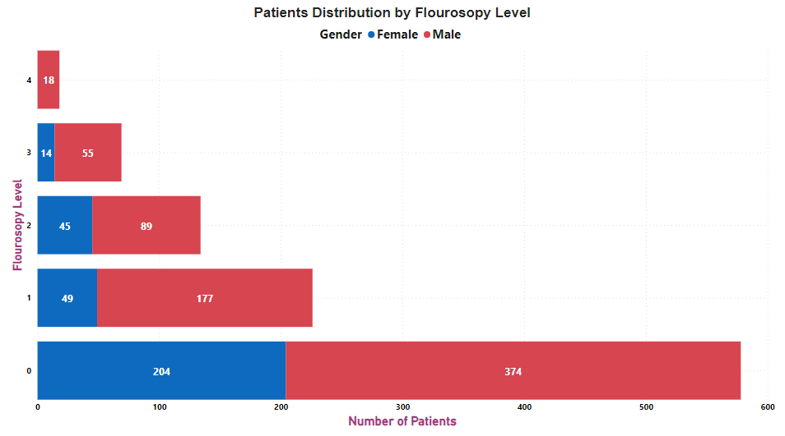
Data Analysis

Slide 20
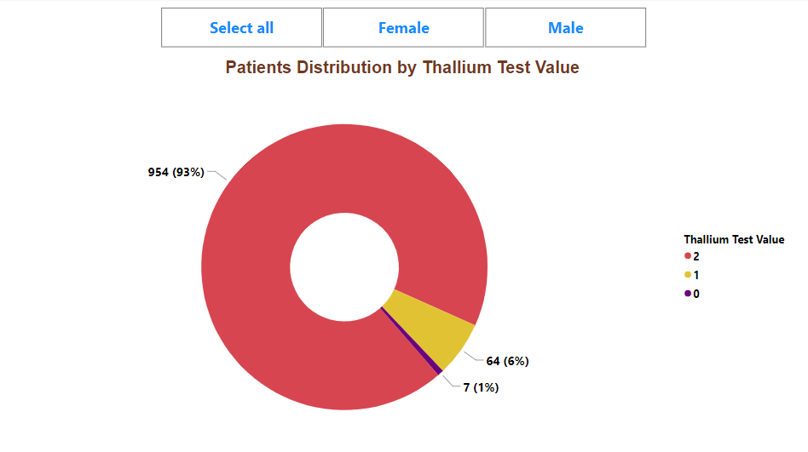
Data Analysis

Slide 21
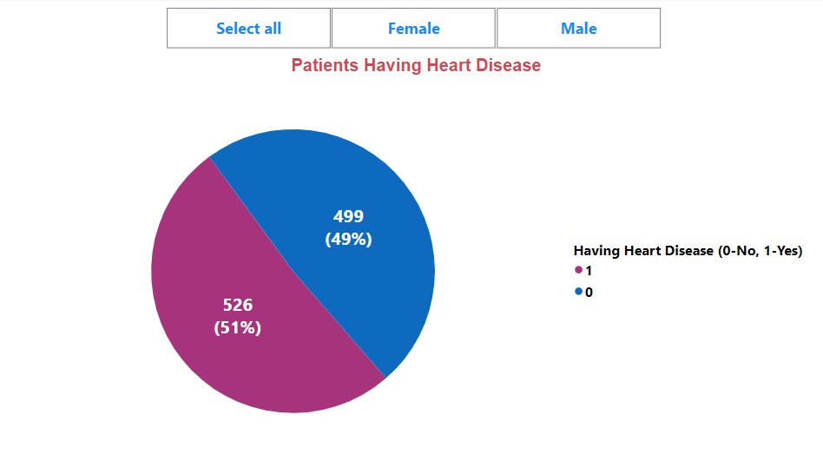
Data Analysis

Slide 22
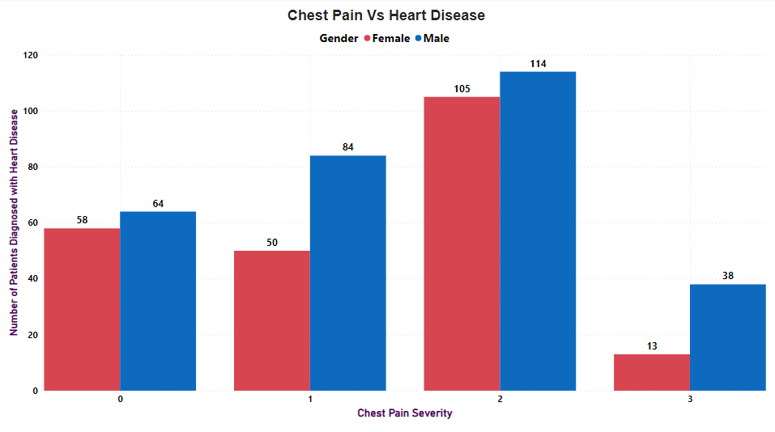
Data Analysis

Slide 23
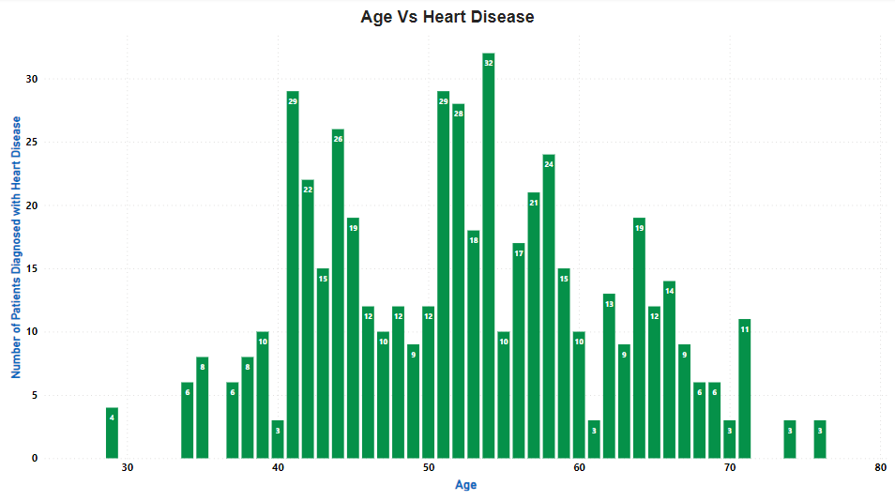
Data Analysis

Slide 24
Insights
Total number of patients are 1025 out of which 312 are females and 713 are males.
The average age of patients is 54.
48.5% of patients (13% females and 35.5% males) don’t have any kind of Chest Pain.
Only 7.5% patients (77 patients – 13 females and 64 males) have very severe Chest Pain.
Most of the patients between the age of 55 and 65 have the highest Resting Blood Pressure (Diastolic value) which is greater than 150mg/dl. This shows they are more prone to High Blood Pressure.

Slide 25
Insights
34% of the patients (74 females and 271 males) have Exercise Induced Angina which means they feel chest pain due to the insufficient blood flow to the heart muscle during physical exercise.
390 patients have Oldpeak value of 0.8, which is not severe but have moderate level of ischemia (reduced blood flow to the heart).
47% patients have normal slope value of 1 as compared to 46% patients who have slope value of 2. But 7% patients have a slope value of 0, which shows more severe ischemia or coronary artery diseases.
18 patients (all male) have flourosopy level of 4, which is very critical and requires immediate action. 56% of the patients have flourosopy value of 0, which indicate their heart works fine.

Slide 26
Insights
A total of 853 patients (267 females and 586 males), approx. 83% patients have Serum Cholesterol(SC) Value greater than 200mg/dl, which increases the risk of Cardiovascular Diseases.
Only 15% patients (42 females and 111 males) have Fasting Blood Sugar levels greater than 120mg/dl. This indicates that they are either prediabetics or have Type-2 Diabetes.
Only 1.5% patients (11 females and 4 males) have Resting Electrocardiographic value of 2, which indicates signs of Heart Attack.
48.5% patients don’t have any kind of cardiac abnormalities.
Male patients have good Resting Electrocardiographic Results as compared to female patients.

Slide 27
Insights
Around 93% patients have Thallium Test value of 2, which shows decreased blood flow to the heart or even a scar tissue in that region.
Approximately 21% patients (105 females and 114 males) having Chest pain Severity of 2, got diagnosed with Heart Disease. From the chart also we can see that males are more prone to heart diseases.
51% (almost half) of the patients are diagnosed with Heart Disease.
Patients within the age range of 40-45 and 50-60 have shown the signs of Heart Disease.

Slide 28
Thank you
@ Vishal Morya

